Slide 1
Welcome to the VGRS Grantee Training!
This session is being recorded
Please mute all microphones
Place all questions or comments in the “chat” for discussion at the end of the presentation, if time permits. If we do not get to your question today, it will be answered via email, within the Q&A document provided to attendees, or by other means.
Links to this slide deck and the recordings for each training session will be published on the VETS Grantee Reporting System | U.S. Department of Labor (dol.gov) no later than August 23.

Slide 2
VETS Grantee Reporting System (VGRS) Grantee Staff Training
August 13-15, 2024

Slide 3
Training
Team
Khatera Falah
  VGRS Scrum Master / Business Analyst
    DOL OASAM OCIO
      Trainer
Jacob Merkel
  VGRS Developer
    DOL OASAM OCIO
      Training Support

Slide 4
Agenda
Training Kick-Off
Objectives
Scheduled Sessions
Grantee Staff Role
System Overview
How to access VGRS
System Features
System Demo
Grantee Training
System Overview
User Management
Grantee Organization Management
Grant Record Management
Performance Report Review Process (Workflow)
Performance Report Exports

Slide 5
VGRS Kick-Off
Grantee Staff Training

Slide 6
Objectives
The VETS Grantee Reporting System, also known as VGRS or “Vigorous,” will replace the Microsoft Excel and Portable Document Format (PDF) forms currently used to collect project and performance information from VETS’ grant recipients.
The initial launch is a minimum viable product (MVP) that replaces the quarterly data collection and report functions of the VETS-701 HVRP Technical Performance Report (TPR) Excel workbook and the VETS-702 Technical Performance Narrative (TPN) PDF document.

Slide 7
VGRS in Production
VETS staff and Grantee staff can complete the tasks associated with quarterly performance reporting entirely within VGRS beginning with Program Year (PY) 2024 Q1.
Those tasks translated into VGRS are as follows:
Over time, more features for HVRP will be developed and pushed into the production environment. These will be done via phased releases.
User Management
  Registration Process of DOL users (assignment of GOTRs)
  Registration Process of Grantees
Grantee Organization Management
  Grantee Organization Information
  Provision Grantees Membership
Grant Record Management
Summary, Goals, Budget, Personnel, Grantee User Access, Participants & Enrollments, Outcomes, Demographic Summary, Performance Reports, History, Grant Submission Status
Performance Report Management & Review Workflow
Submit Quarterly Performance Reports

Slide 8
Scheduled Sessions
The following dates are the upcoming training sessions for all grantees.
  Grantee Staff Training – Day 1
    Tuesday, August 13th at 2:00 – 4:00 PM ET
  Grantee Staff Training – Day 2
    Wednesday, August 14th at 2:00 – 4:00 PM ET
  Grantee Staff Training – Day 3
    Thursday, August 15th at 2:00 – 4:00 PM ET
  Grantee Technical Assistance Listening Sessions – Optional
    Friday, August 16th at 2:00 – 3:00 PM ET
    Thursday, August 22nd at 2:00 – 3:00 PM ET
If you do not have an invite to any of the above sessions, reach out to your GOTR.

Slide 9


Key Resources
VETS Grantee Reporting System - VGRS (dol.gov)
PY2024 HVRP Participant Tracking Sheet (dol.gov)
HVRP Quarterly Performance Reporting Desk Guide Revised August 2024 with Measure Formulas (dol.gov)
HVRP Glossary of Terms (dol.gov)
Login.gov
Create a Login.gov Account
Login.gov Help Center

Slide 10
User Management

Slide 11
Grantee Staff Role
Grant recipient staff members who provide budgetary, participant/enrollment data, and narratives for quarterly Performance Reports (PRs)
Permission to access only those grants they have been assigned to by VETS staff
Read-only access to permitted VGRS records/data (e.g. Grantee Organization, Grant Record - Summary and Goals modules)
Create/Manage access to permitted Grant (e.g. Budget, Participants, Enrollments, Personnel, etc.)
Create/Manage/Submit Performance Reports (PRs)
A grant must have at least one Grantee Staff user assigned to it to complete and submit the quarterly PR

Slide 12
Grantee Staff Users
There is a limit of four (4) grantee users per grant.
  User access is established at the individual grant level, not the organization level.
  For example, if User A is responsible for inputting budget information for three grants, User A will be counted toward one of the four slots available for each grant.
Any grant that has more than 4 users requesting access may have all users beyond the initial four to be rejected.
  If you need to assign more than 4 users to the grant, contact your GOTR to discuss options.
Who should request access? Grant personnel who input:
  Participant, enrollment, training, services, exit and follow-up information; ​
  Planned budget, actual expenditures, staff hours charged to the grant; and ​
  Performance narrative updates, corrective actions, and performance report certifications.​

Slide 13
How to Access VGRS
Grantee user access to VGRS is a multi-part process:
  Login.gov Account
  VGRS Registration Request
  VGRS Registration Decision: VETS Approves or Denies Registration Request
  Grantee Staff User Management: Assigned to a Grantee Organization and Grant Number(s)
Completing the first three steps will allow you to log into VGRS, but you won’t be able to view or edit your grant information until step 4 is completed.

Slide 14

Login.gov Account
Sign In/Create
Step 1 - you must have a Login.gov account
If you already have a Login.gov account, sign into Login.gov (https://secure.login.gov/)
If you do not have a Login.gov account, Create a Login.gov Account (https://secure.login.gov/sign_up/enter_email)
Login.gov Help Center (https://www.login.gov/help/)

Slide 15
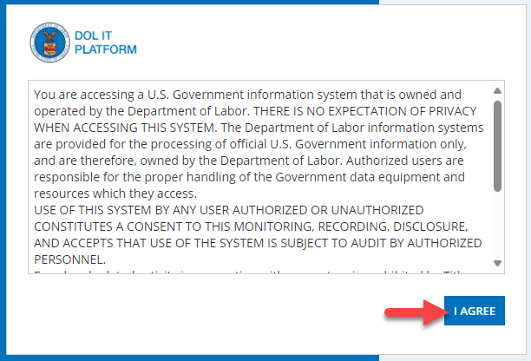
Login.gov Account
Access DOL
Once you have been logged into Login.gov:
You will need to access the VGRS site (https://cmp.dol.gov/suite/sites/vgrs)
You will need to accept the Rules of
Behavior for the DOL environment by
clicking on I Agree

Slide 16
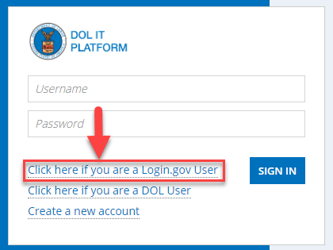
Login.gov Account
Log in as Login.gov User
Once you have your (account created) and are logged into Login.gov:
Click on the Click here if you are a Login.gov User link

Slide 17
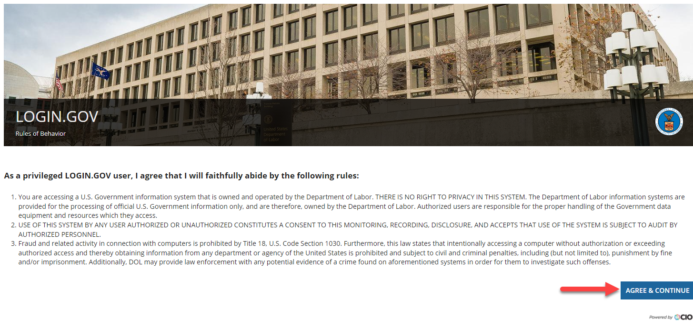
Login.gov Account
Agree to Rules of Behavior
Once you have your (account created) and are logged into Login.gov:
Read the Login.gov Rules of Behavior and click on Agree & Continue

Slide 18
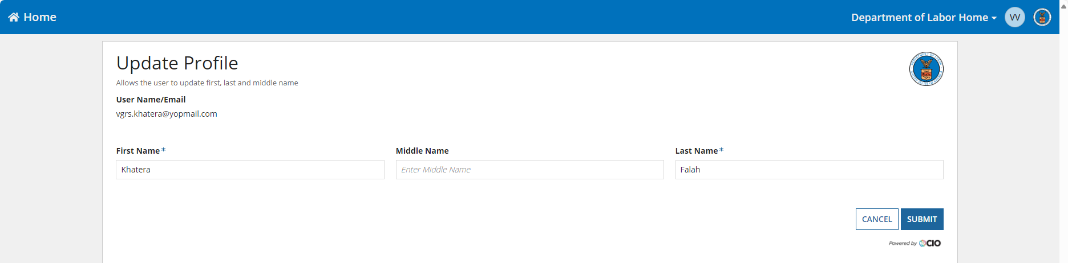
Login.gov Account
Update Profile
Once your account is created and are logged into Login.gov:
Input your First Name and Last Name
Click Submit

Slide 19

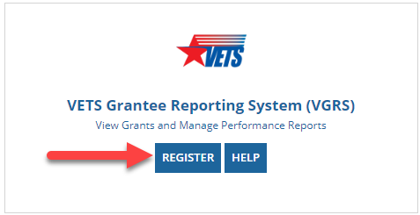
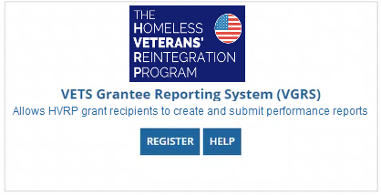
VGRS Registration Request
Find VGRS
Once you have your account created and are logged into Login.gov:
Find the VETS Grantee Reporting System (VGRS) card on the bottom right of the Manage Application Access home page
  Note: Your GOTRs cannot see the Manage Application Access page from their government computer.
Select Register to be redirected to a Registration Request form
Current
Future
Notes:
We recently discovered that the similarities between the system buttons for the VETS Case Management System and VETS Grantee Reporting System are causing some confusion at registration.
We plan to change the VGRS button to what is shown in the bottom right.

Slide 20
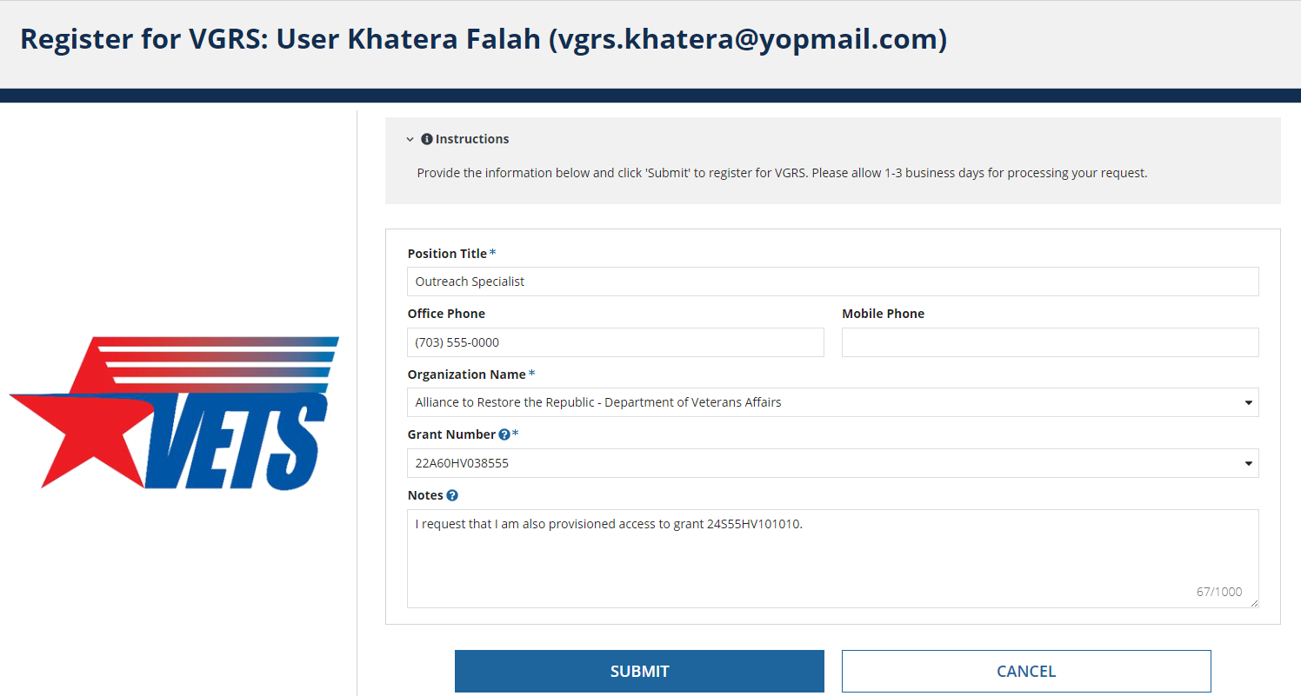
VGRS Registration Request
Submit Form
Fill out the Registration form.
You must select your Organization Name and Grant Number.
If you need access to more than one grant, list the grant numbers in the Notes field AND send an email to your GOTR(s).

Slide 21

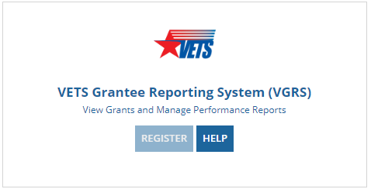
VGRS Registration Decision
Additional Registration Requests Are Blocked
While you are awaiting adjudication of your registration request, the Register button will be grayed out
  This stops potential users from flooding the registration requests queue to allow VETS staff time to respond

Slide 22
VGRS Registration Decision
Registration requests are reviewed by VETS staff and are either Approved or Rejected
  This will likely be your GOTR or another member of your grant’s primary service delivery state
As Grantees, you will receive an email notification informing you of the decision made for your individual request.
If your request was:
  Approved – you will be able to you access VGRS (https://cmp.dol.gov/suite/sites/vgrs) directly
  Rejected – you will be able to resubmit a request using all previous steps

Slide 23
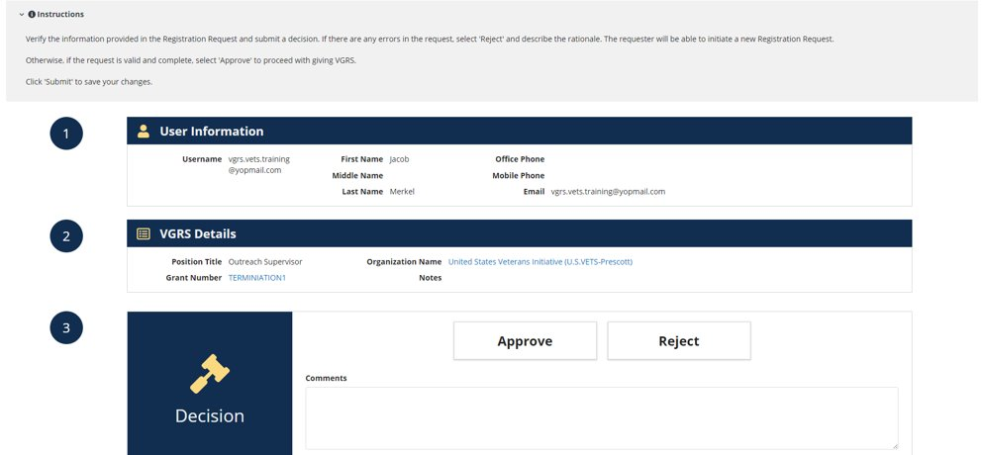
VGRS Registration Decision
VETS View
Here’s how VETS staff adjudicate grantee registration requests

Slide 24

VGRS User Profile
Once approved, you will be able to view your VGRS user profile
Consists of two major sections:
  User Profile
    Consists of all your provided contact information at the time of your registration request
  VGRS Profile Settings
    Consists of your provided Position Title and the records you have been provided access to (grantee organization and grant records)
When VETS approves your registration request, VETS staff must manually add you to your requested Organization and Grant Numbers(s) selected on your registration request
  Therefore, if you require access to more than one organization or grant, you must include them in your request. Otherwise, you will need to contact your GOTR(s) to receive the additional access
If you notice that your associated access is incorrect or incomplete, contact your GOTR immediately.

Slide 25
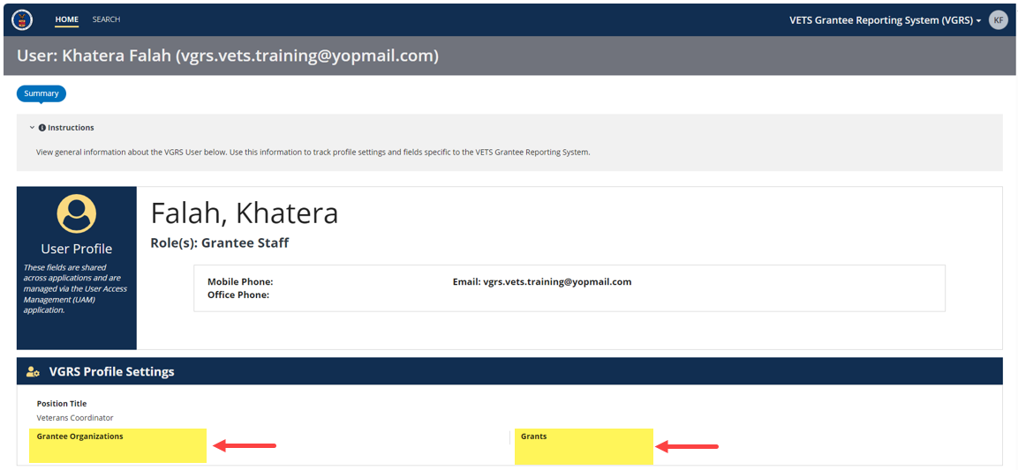
VGRS User Profile
No Access View

Slide 26
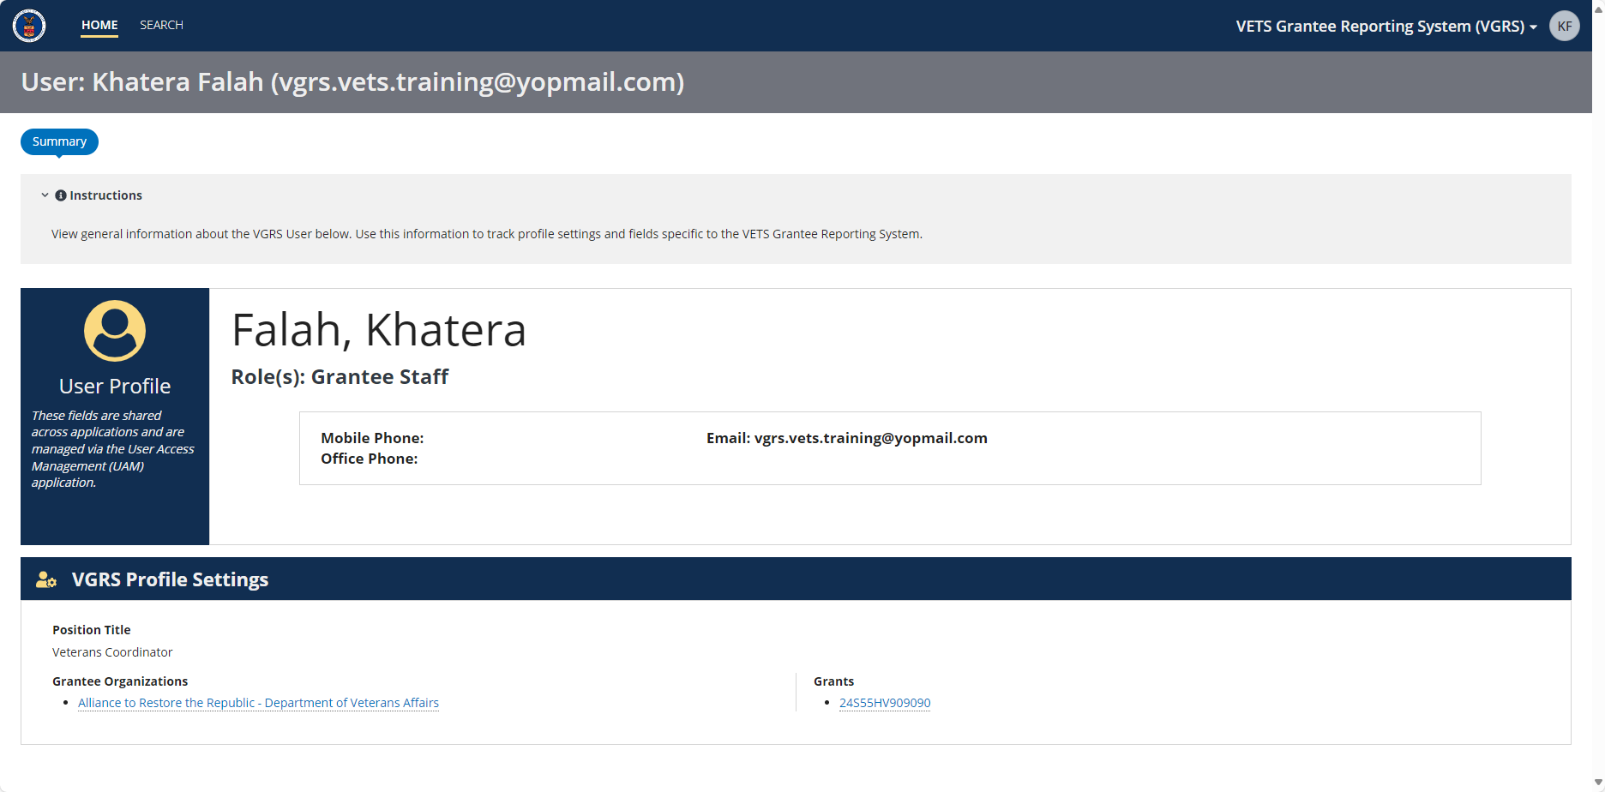
VGRS User Profile
Access View

Slide 27
VGRS System Overview

Slide 28
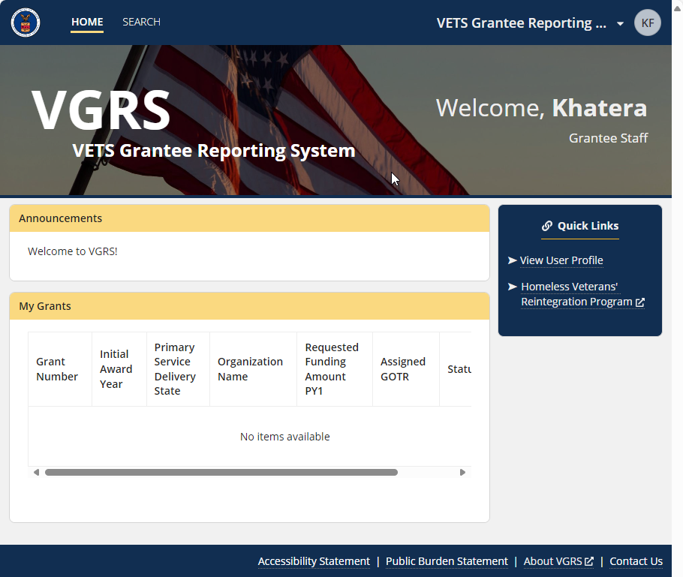
Home Page
Navigation bar
Welcome banner
Announcements section
My Grants
Quick Links sidebar
Footer

Slide 29
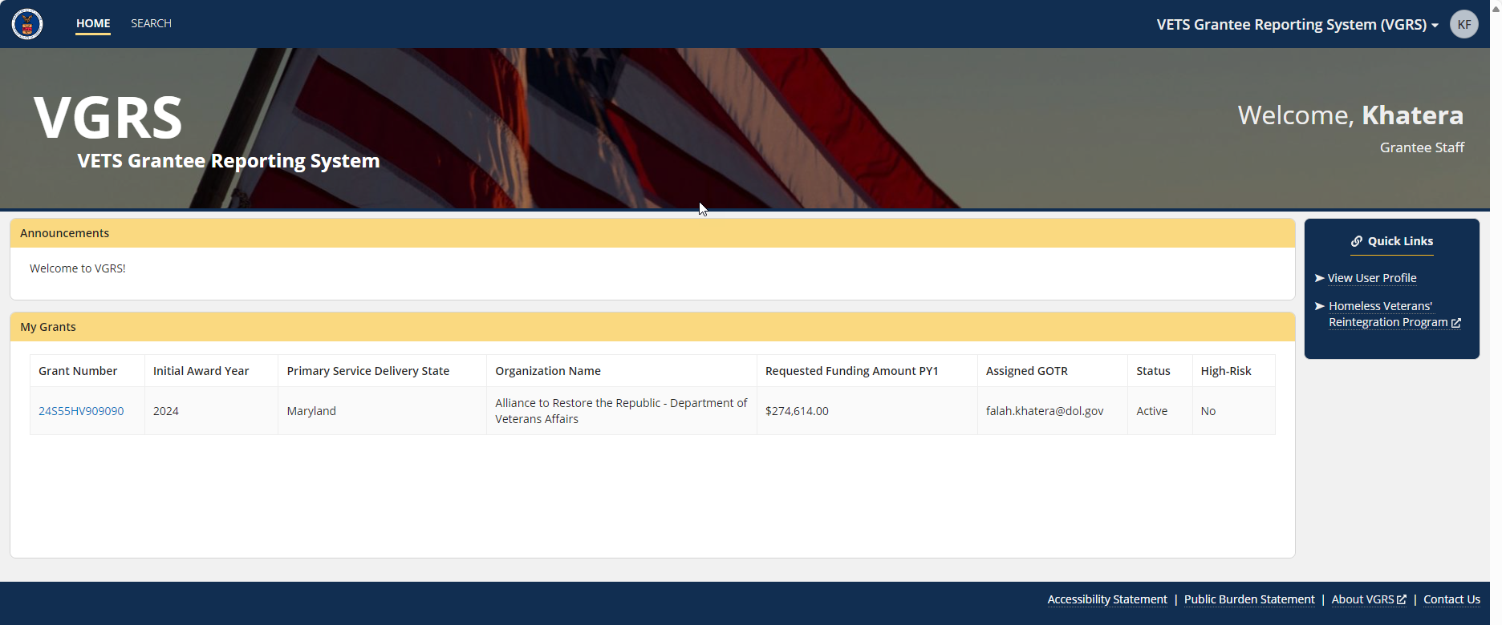
Home Page – View with Grant Access

Slide 30
Navigation Bar
Accessible across the application
Features the following components:
  Main Menu
    DOL Logo & Home
    Search
  CMP Application Access Menu
  CMP User Icon

Slide 31
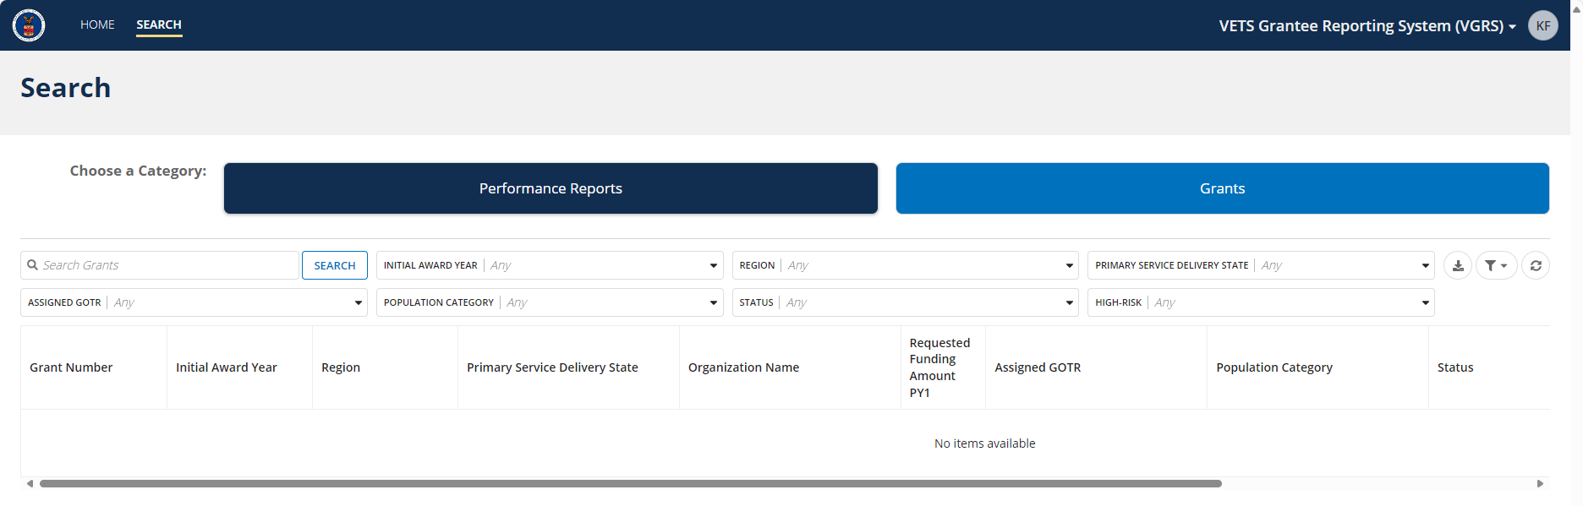
Search
Provides users with an easy to navigate grid to filter, sort, or search records via two categories
  Categories are Performance Reports and Grants
    As Grantees, you will only be seeing the grant records of those you have been provisioned direct access to which includes all related performance report records
  Users are encouraged to save their own filter selections and default them to make the grids more manageable

Slide 32
Search, Filter, and Sort
VGRS consists of grids/tables throughout the application, certain grids are more specialized and include the ability to search, filter, and sort
Search feature works across the grid, in which any text input into the search bar will filter to show only those that match
Filters are used for the specific related columns
  Users can save multiple filters for easy view of different criteria, including creating a default view
  These different saved filters will not be present to other users, only the one who had created them
Basic column sorting is default across these special grids

Slide 33

System Demo
Demonstration & Review of:
Home and associated links
Navigation Bar
Search page and categories
  Tips on how to use filters
  R
Brief look at record types

Slide 34
System Terms – Part 1
Related Actions are action buttons that located in the upper right region of the window, these allow you to manage the content of the page you are viewing
  As Grantees, you will see Related Actions across certain grant record modules (Budget, Personnel, Participants, and Performance Reports) and performance report modules (Summary and Narrative)
Instructions provide a brief explanation of the items seen on any given page or module. This text will often include explanation of any actions that may occur.
Learn Mores are detailed information meant to break down fields, measures, or data to better understand what a form or grid may be displaying.

Slide 35
System Terms – Part 2
Tooltips are manageable bite-sized help text for a field or measure within the system, that users hover over to get further information about what is being asked.
Modules are sub-sections within records, designed to perform specific tasks and manage data. For example, in the context of a grant (which is a type of record), modules contain detailed information and functionalities related to various aspects of the grant.

Slide 36
Grantee Organization Record

Slide 37
Grantee Organization Records
Records are created by VETS staff
The Summary dashboard include basic information about the organization
  Identifiers
  Contacts
  Address
  Notes
Grantees can only see the records they have been directly provisioned access to

Slide 38
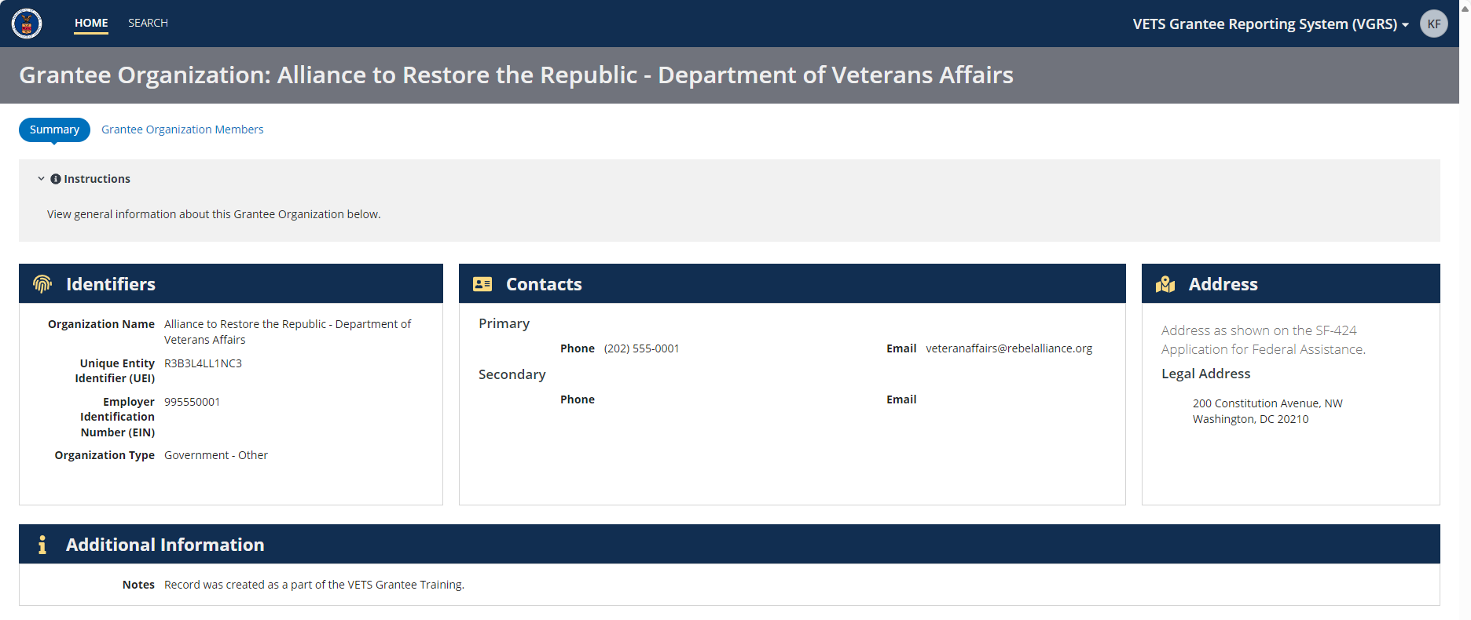
View Grantee Organization Record

Slide 39
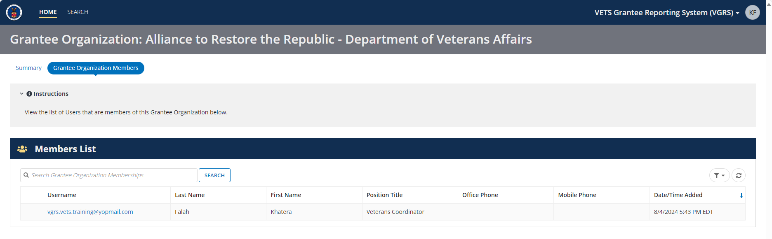
Grantee Organization Members List
Lists the four grantee staff users that have been provisioned access to the organization

Slide 40
Grant Record Management

Slide 41
Grant Record
Grant records are created by VETS Staff
Only grantee staff users that have been provisioned access to a specific grant will be able to view the grant record
Grantee Staff with grant access can update the Budget and Personnel – Staff Name/Time
Only VETS staff can update Summary, Goals, Personnel – Positions/FTE, and Grantee User Access modules

Slide 42
Grant Summary Dashboard
Includes all the high-level grant information:
  Identifiers
  Assignments
  Award Information
  Service Delivery Area
  Additional Information
  Statuses (Active/Terminated, Standard/High Risk)
  Notes
Only VETS staff can update this module’s information
  Including the ability to report a grant’s termination, update the grant’s risk indication, or delete a grant record

Slide 43
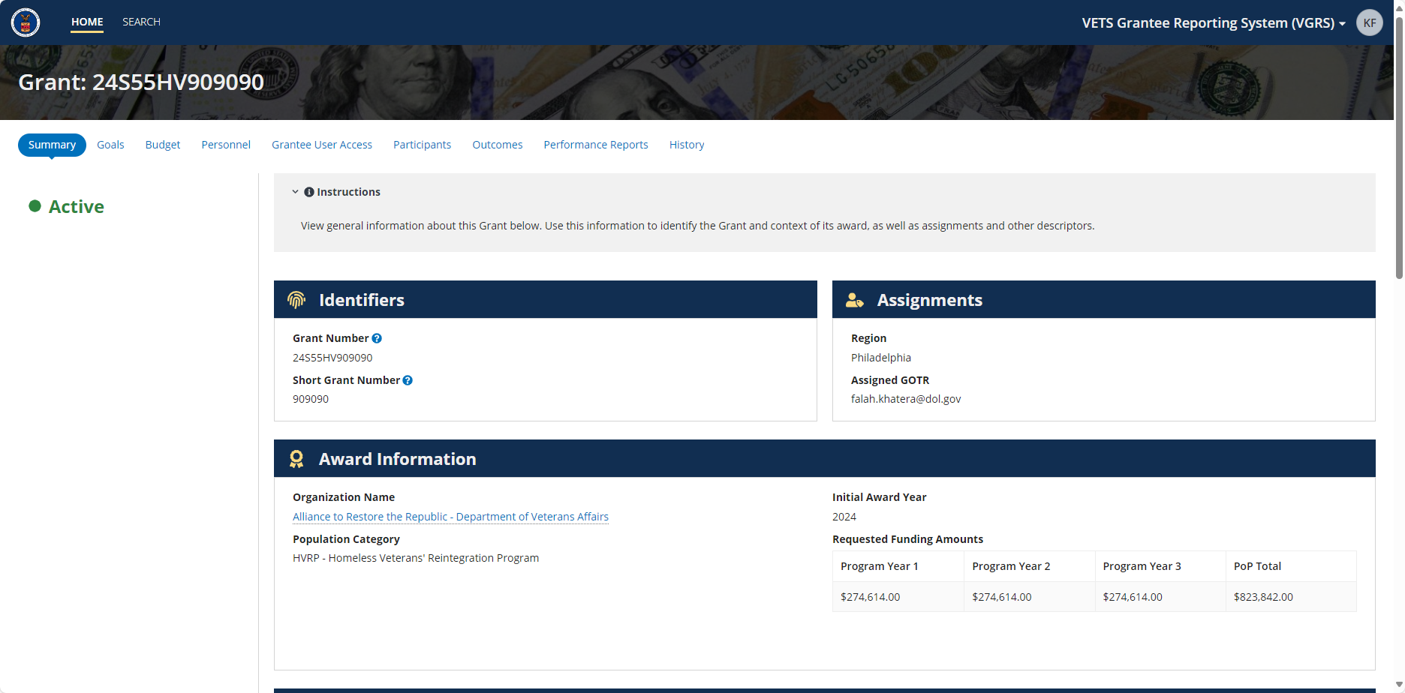
View Grant Summary Dashboard

Slide 44
Goals Module
Provides a Period of Performance (POP) view of all measures within multiple tables split by category
  Each category has its own Learn More feature to better understand the measures listed
Only VETS staff can update this module
Grantee staff users can view, but not edit, the Goals module
VETS staff are still updating the Goals module in VGRS, so some grantees may see blank entries until those are finalized (estimated 8/31).
In addition, a system update that is planned for 8/19 will allow VETS to complete the following Goal module updates:
  All PoP Year 3 grantees will have zero value goals for PoP Q1-Q4
  All PoP Year 3 IVTP grants will have zero value goals for Episodically Homeless indicators.
  Any grant with zero value goals in their approved Planned Goals Chart.
  All PoP Year 1 grants with an Abstract or Planned Goals Chart Condition of Award (COA) that has submitted a revised Attachment A - VETS-704.

Slide 45
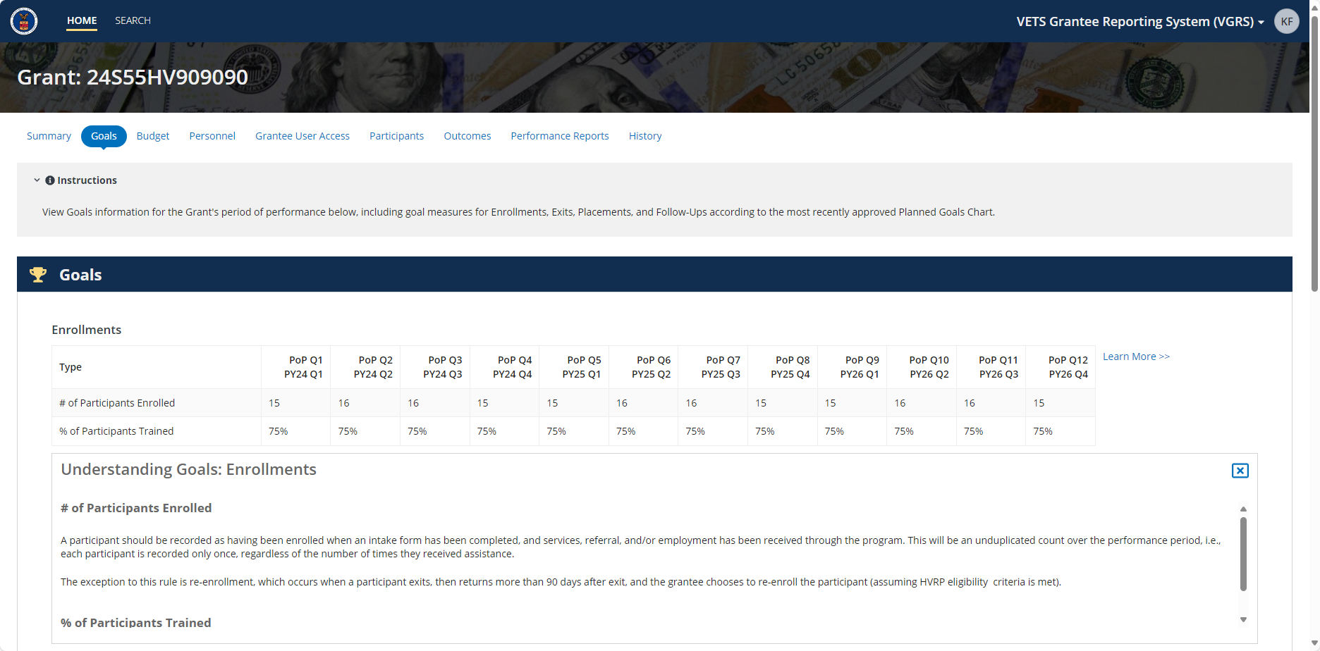
View Goals Module

Slide 46
Budget Module
Provides a PoP view of all the budget related measures
Measures are split between Planned and Actual categories
  Each category has its own Learn More feature to better understand the measures listed
VETS and Grantee staff can update this module

Slide 47
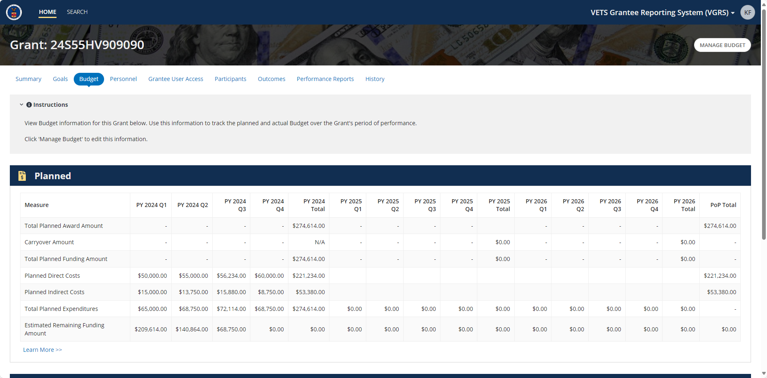
View Budget Module

Slide 48
Personnel Module
Provides a POP view of the employees within positions and their related time allocation across quarters
This module calculates actual Percentage of Time (PoT) from the position’s designated PoT
VETS and Grantee staff can update this module
  VETS staff can manage the different positions listed
  Grantee Staff can manage the employee information listed per each position

Slide 49
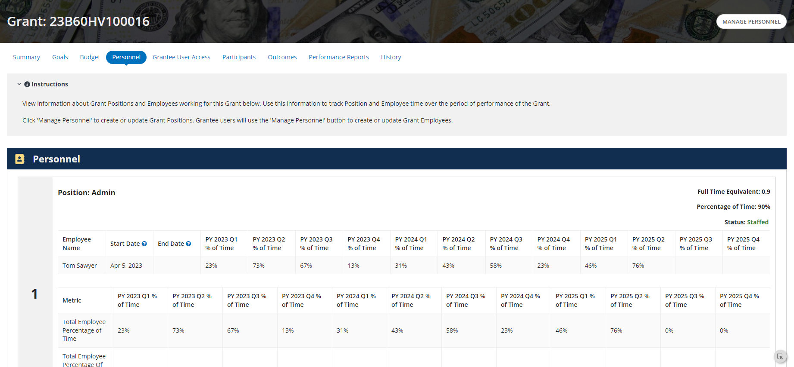
View Personnel Module

Slide 50
Grantee User Access Module
This module lists all Grantees with user access to this grant
  Being listed here provides the grantee the ability to view of the grant record and manage certain modules (Budget, Personnel, Participants, and Performance Reports)
VETS staff can add Grantees to a grant record

Slide 51
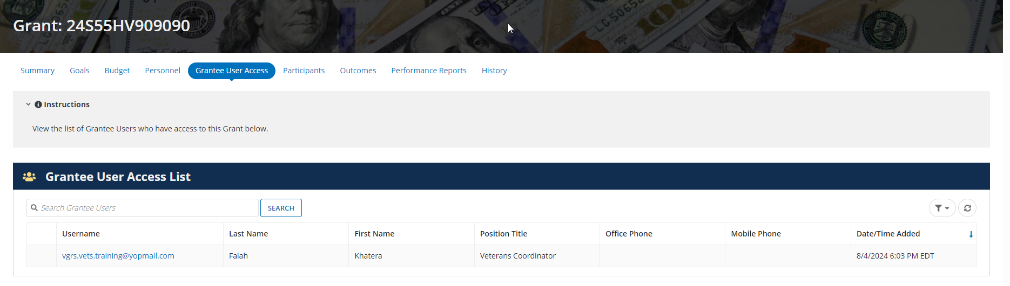
View Grantee User Access Module

Slide 52
Participants Module
Participants form requires the entry of demographic and military service information before an enrollment can be created
  Enrollments are created under each participant
  A participant can have multiple enrollments, but the service start date of the subsequent enrollment must be at least 90 days after to the previous enrollment’s service end date
Users can explore the data via nested or tabular views
  Data can be exported into an Excel file for each of the tabular grids
Grantee Staff manage this module
  However, all users with grant access can see the inactive participant notifications within this module
Disclaimer: VGRS is a performance reporting system, not a case management system. Grantees should maintain case files on their participants independent of the data entered in VGRS.

Slide 53
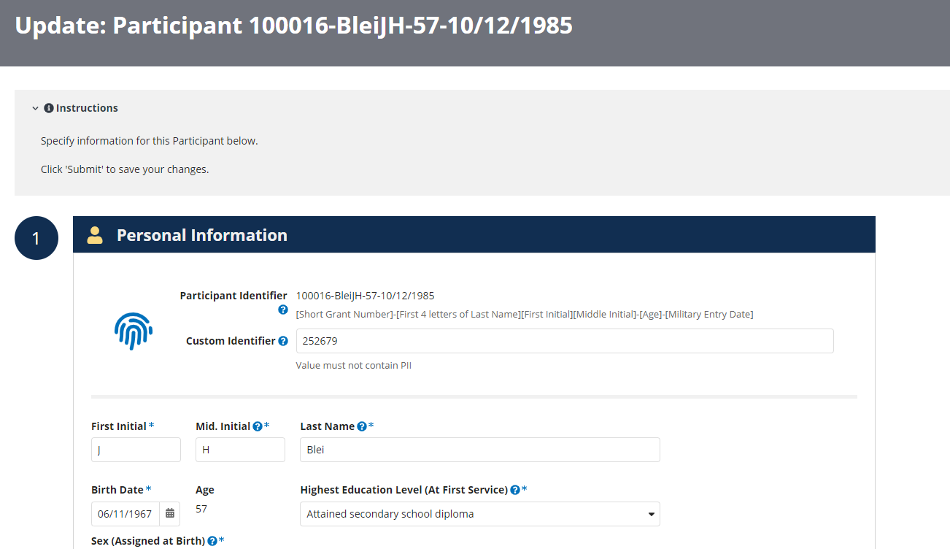
Participants Module – Form View
VGRS generates participant IDs from data entered in the Participant module.
Grantees may enter their own custom identifier as well.

Slide 54
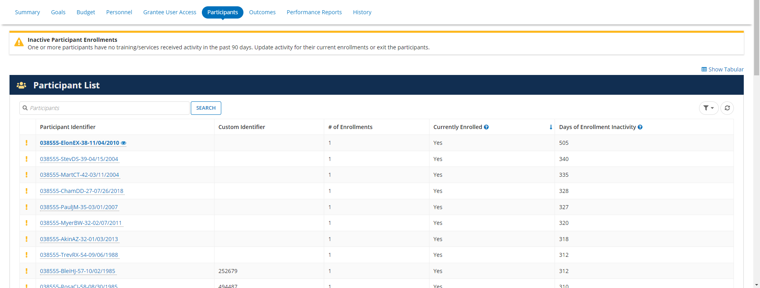
Participants Module – Nested View

Slide 55
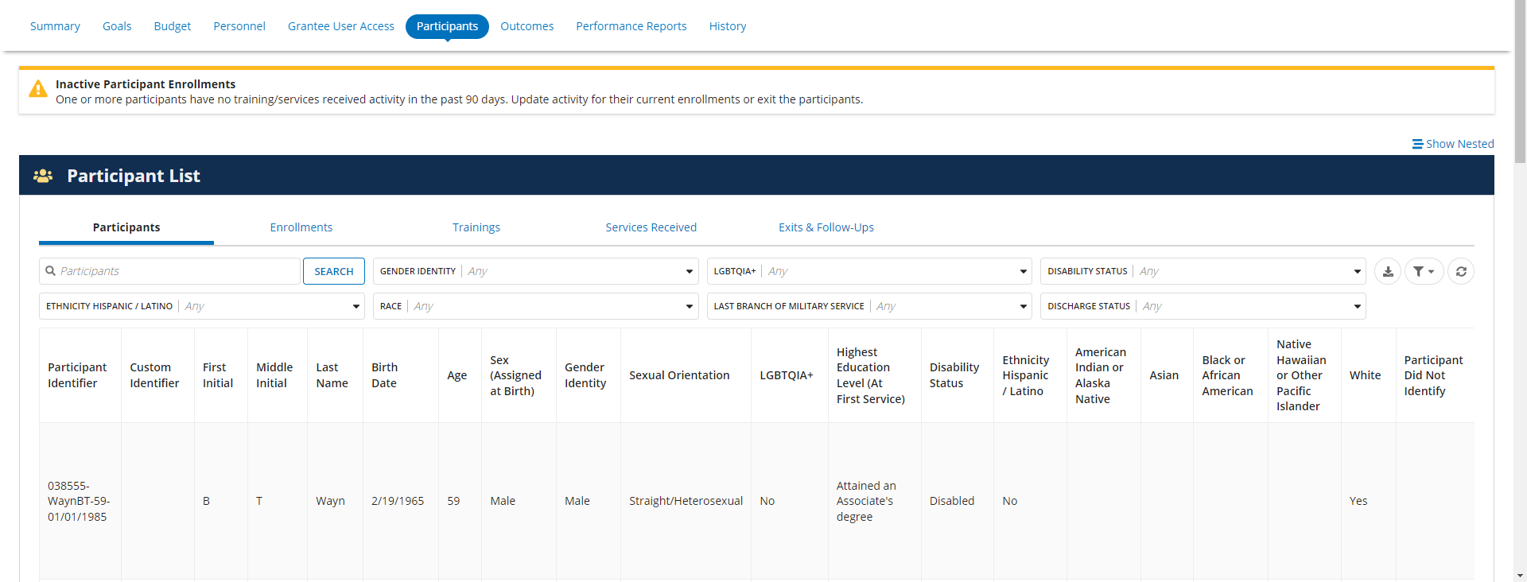
Participants Module – Tabular View

Slide 56
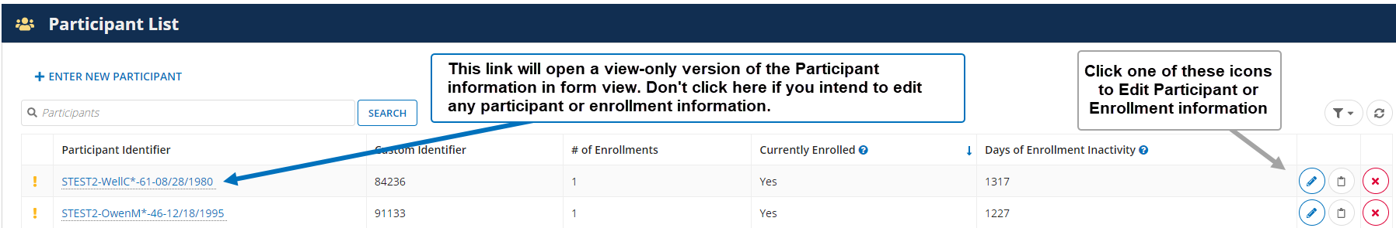
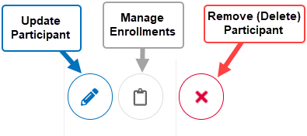
Navigating the Participant & Enrollments Modules
Navigating Participant and Enrollment Views

Slide 57
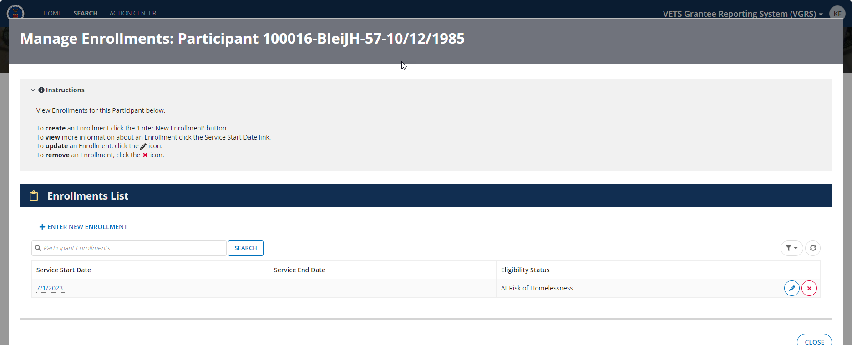
Enrollments Module – Participant View

Slide 58
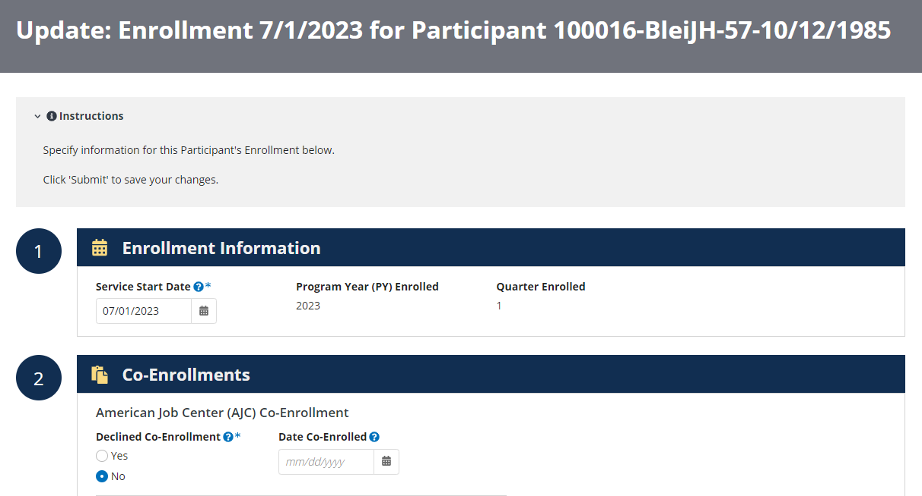
Enrollments Module – Form View

Slide 59
Enrollments Module – Trainings
The Enrollments form has a Training section that captures the participant’s training, if any, from service start to service end.
Rows can be added by selecting the + Add Training link below the grid
Entries can be removed by clicking on the red x to the right of the desired row
Training entries are required only when a row has been created
  Therefore, if no training rows have been created, the form may submit (to save) as long all other required rows have correct inputs
  If a training row has been created but no data has been input, the enrollment will not submit (to save)
  Note: The enrollment must have at least one Service or Training date received recorded in VGRS to be considered an enrollment for the reporting quarter

Slide 60
Enrollments Module – Trainings Fields
The information captured per training row is as follows:
  Training Type
  # of Hours
  Start Date
  End Date
  PY Completed*
  Quarter Completed*
  Notes
*denotes automatic calculation by VGRS once the End Date is entered

Slide 61
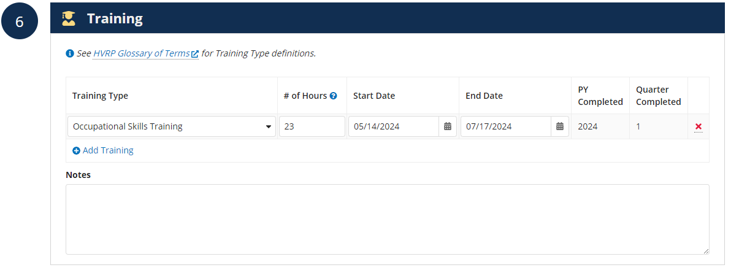
Enrollments Module – Trainings View

Slide 62
Enrollments Module – Services Received
The Enrollments form has a Services section that captures the participant’s services received from service start to service end, and any follow-up services provided up to four quarters after exit.
Rows can be added by selecting the + Add Service Received link below the grid
Entries can be removed by clicking on the red x to the right of the desired row
Services Received entries are required only when a row has been created
  Therefore, if no services received rows have been created, the form may submit (to save) as long all other required rows have correct inputs
  If a services received row has been created but no data has been input, the enrollment will not submit (to save)
  Note: A participant must have at least one service or training date recorded in VGRS to be considered an enrollment for the reporting quarter

Slide 63
Enrollments Module
Services Received Fields
Entries are to be added/updated for each service type per reporting quarter completed
The information captured per service is as follows:
  Service Type
  Date Received
  PY Completed*
  Quarter Completed*
  Notes
*denotes automatic calculation by VGRS once the Date Received is entered

Slide 64
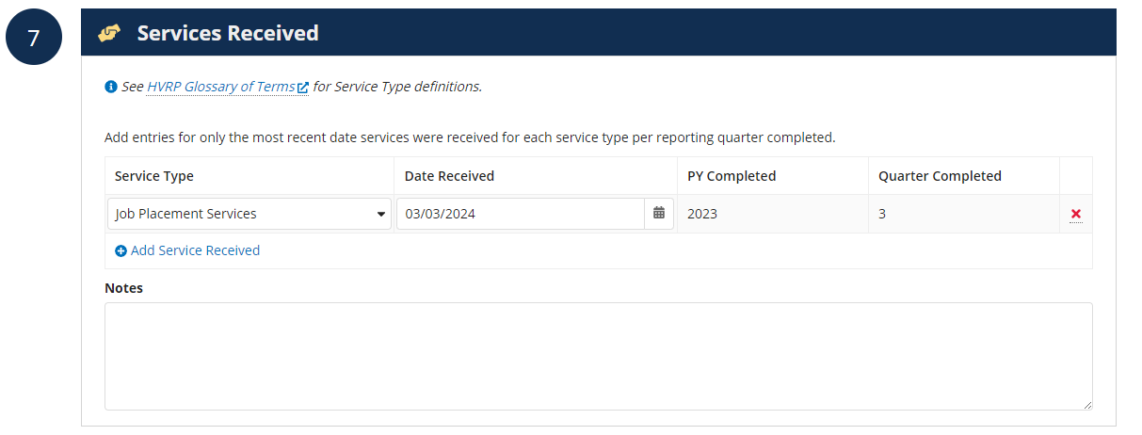
Enrollments Module – Services Received View

Slide 65
Enrollments Module – Exits
Exits section collects the information related to a participant’s enrollment ending. This enrollment end could be due to having been placed or any other reason for exit.
This section collects trackable measures regarding housing status at exit, information about the placement, and/or what the other reason for exit is.
Fields are not required until a Service End Date has been input
  When a selection is made for the Placed in Employment field (located in the Placement Information subsection) will display conditional requirements depending on the answer for placement

Slide 66
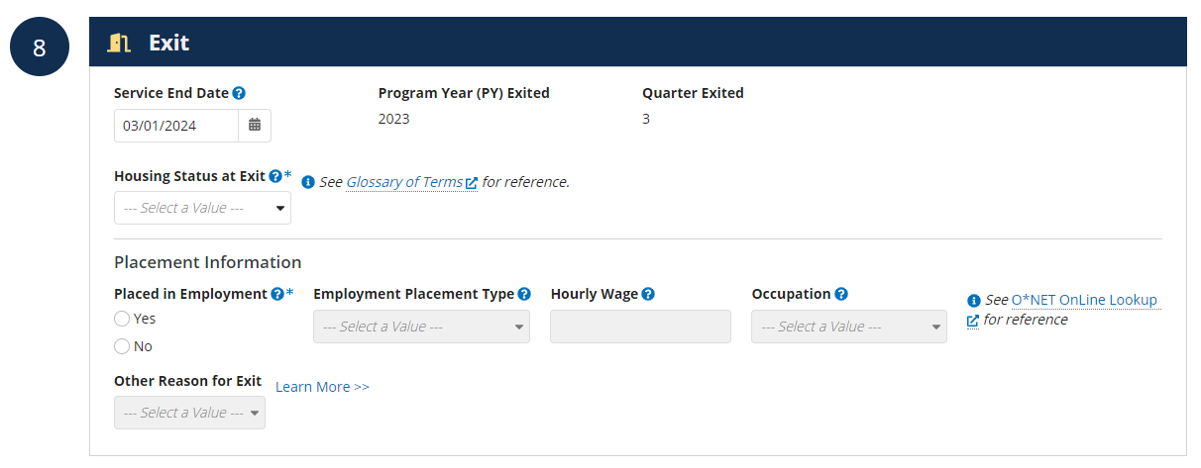
Enrollments Module – Exits View

Slide 67
Enrollments Module – Follow-Ups
Follow-ups section will only appear once a Service End Date has been input
This section collects the participant’s post exit employment information. Follow-up activities are recorded up to four quarters after the quarter of exit for each participant exiting the program until the end of the grant’s PoP
Dates to determine each of the quarters after exit are calculated based on the Service End Date

Slide 68
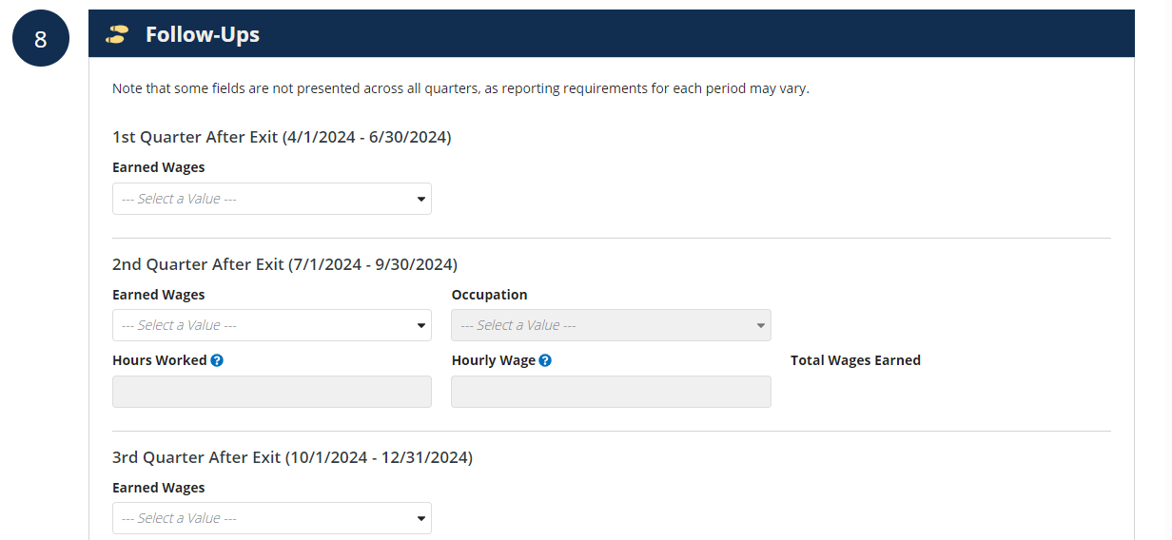
Enrollments Module – Follow-Ups View

Slide 69
Grant Record Demo
Demonstration & Review of:
Grant record
Detailed demonstration of Participants and Enrollment modules

Slide 70
Outcomes Module
This module pulls in data from the Goals, Budget, and Participant/Enrollment modules and calculates the goals versus the actuals to provide a preview of all key metrics for the grant
  The Percentage of Cumulative Goal Achieved is displayed for each indicator
  Only scored measures have a heatmapping color scheme
  In the grant record, this scheme only colors up to the grant’s current quarter
Users can explore the data via all outcomes or scores-focus views
  Data can be exported into an Excel format for each of these views
All users with grant access have view-only access to this module and can (re)calculate the module as needed
  This module has no user input other than recalculating as needed

Slide 71
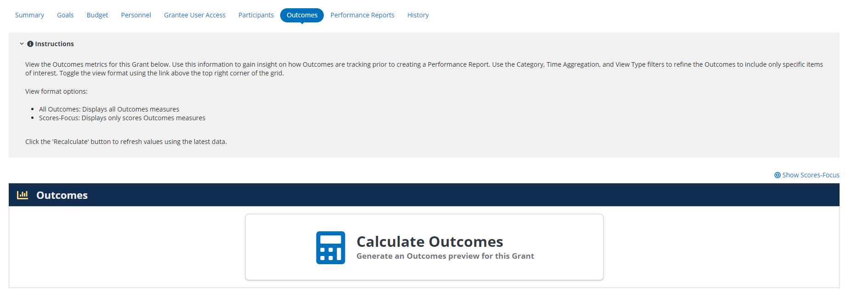
Outcomes Module – Initial View

Slide 72
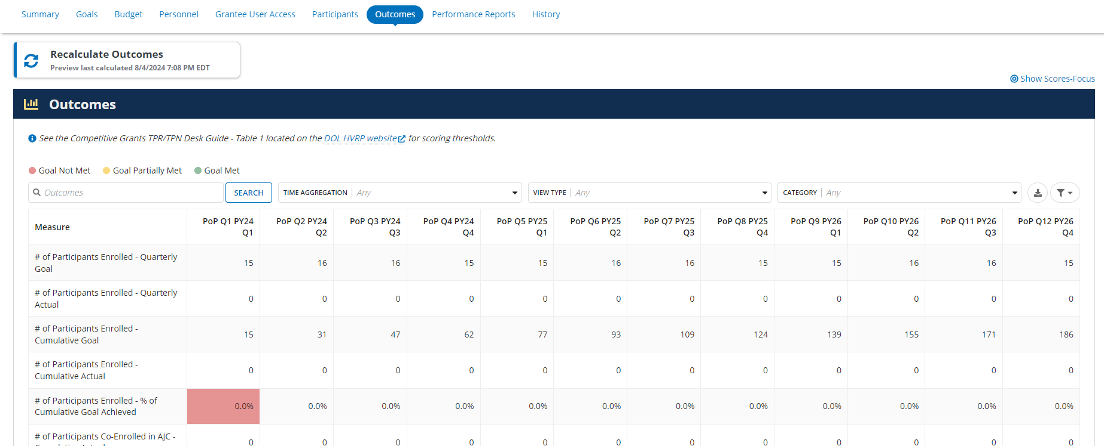
Outcomes Module – All Outcomes View

Slide 73
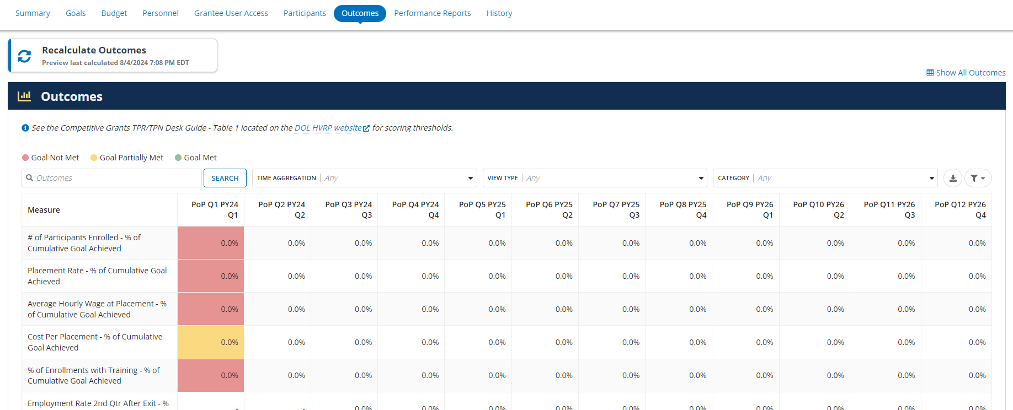
Outcomes Module – Scores-Focus View

Slide 74
Performance Reports Module
This module lists all created performance reports and their submission statuses
The table provides a search and filter feature
Grantee Staff manage this module

Slide 75
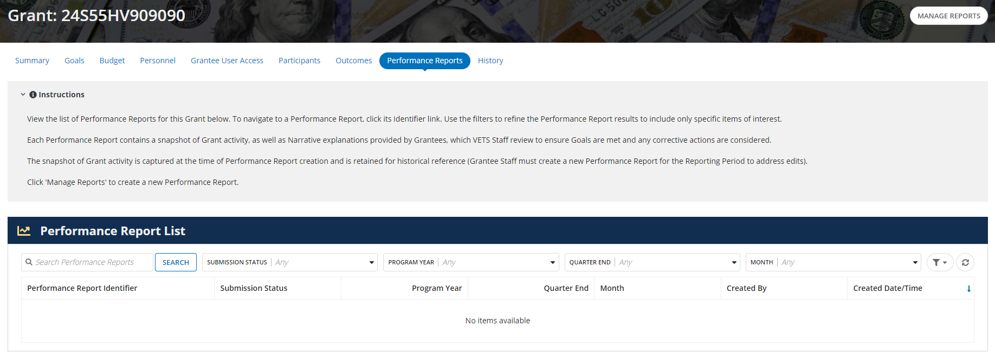
View Performance Reports Module

Slide 76
History Module
This module lists all updates made within the Summary, Goals, Budget, Personnel, and Grantee User Access modules
  Updates to the Participants and Enrollments are not captured due to the high volume of edits in those modules
The table provides a search and filter feature
All users with grant access have access to the History module

Slide 77
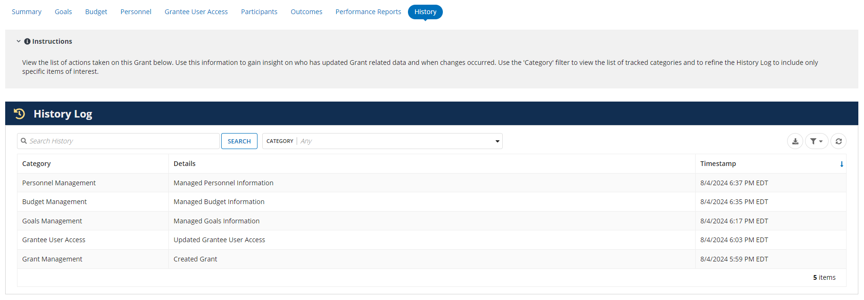
View History Module

Slide 78
Performance Report
Management

Slide 79
Performance Reports Identifiers
Performance Report (PR) identifiers include the following four pieces of information:
000125-2024-1-SEP
  000###: (related) Short Grant Number
  20##: Reporting Program Year (PY)
  #: Reporting Quarter Number (will show as 1, 2, 3, or 4). If the PR is a monthly submission, this will show as “N/A”.
  AAA: Reporting Quarter Month End

Slide 80
Performance Reports Records
Performance Reports are snapshots of grant activity and data recorded in VGRS at the time of PR creation
Only grantees provisioned grantee user access to a grant may manage the related performance report records
  Grantees may manage the reporting period in the Summary module and the Narratives module prior to submitting the report to VETS for review
VETS staff have access to all performance reports regardless of submission status

Slide 81
PR Summary Dashboard
Consists of the following information:
  Submission Status – statuses can be Draft, Submitted, or Returned
    Draft – the record is manageable and open for grantee staff to finalize prior to submitting to VETS
    Submitted – the record has been submitted to VETS and is no longer manageable
    Returned – the performance report has been returned and remains for archival purposes only; grantee staff are required to create a new one for the reporting period
  Validation Checker – tracks the progress of Narrative responses to required fields and when the record is eligible to being submitted to VETS
  Grant link and Live View – includes grant status + basic grant information
  Created Date & User – provides the date and the user’s email who had created the performance report record
  Reporting Period – is the designated time frame for the performance report to be scored and submitted for
    Cannot be a future period –must be the current or prior quarter based on today’s date

Slide 82
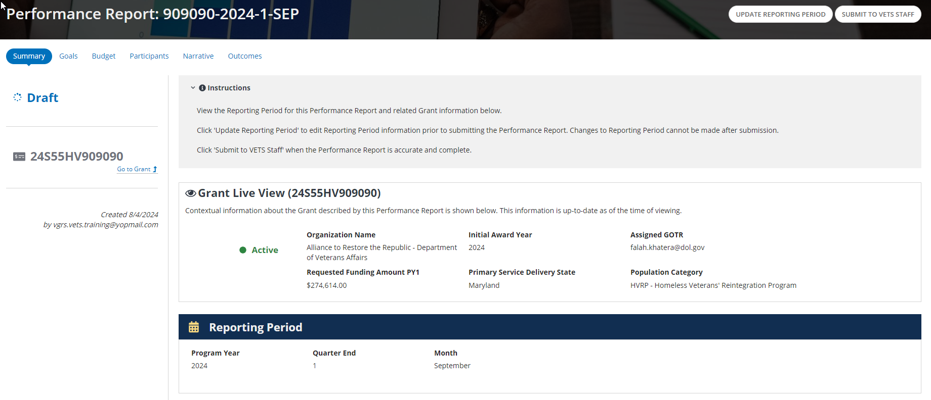
View Performance Reports Records

Slide 83
Narrative Module
Narrative allows grant recipients to report on this reporting period’s achievements, activities, scores, corrective action plans (if applicable), personnel charged to the grant, and the funds expended by program year for the grant.
Grantee staff can manage the narrative (only when the report is in draft status) to update and reflect any given period of performance
  Grantee staff must enter Service Address the first time they manage and submit the performance report
  Other than Service Address, all other fields in this section are not required to save but are required to submit

Slide 84
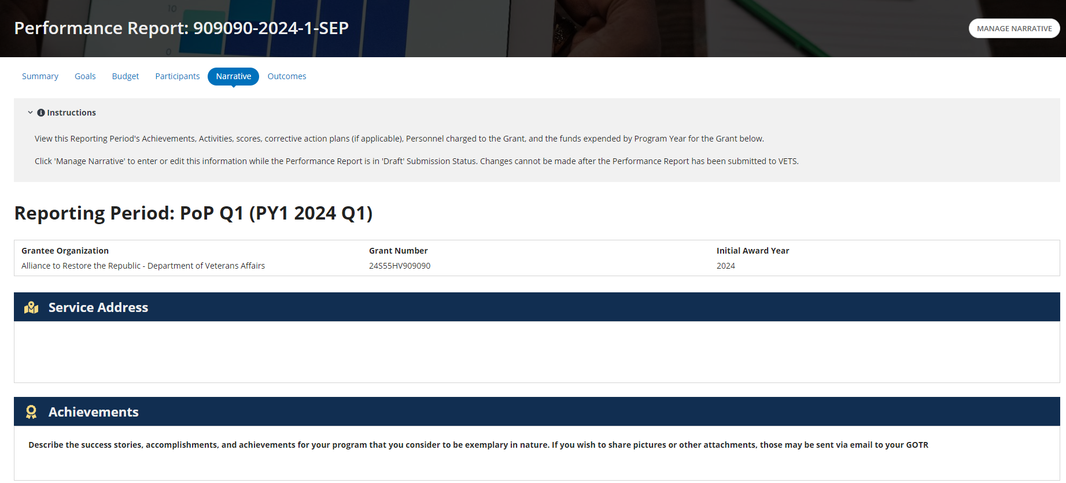
View Narrative Module

Slide 85
Submit to VETS
When submitting to VETS, users are required to confirm their action twice before a system validation begins to confirm the Narrative is completed as required for their grant status (Active vs Terminated)
User may see a Validation Failed screen, if their Narrative module had not been started nor completed
  Until a Narrative module has been completed, according to the grant status, the Performance Report is ineligible for submission

Slide 86
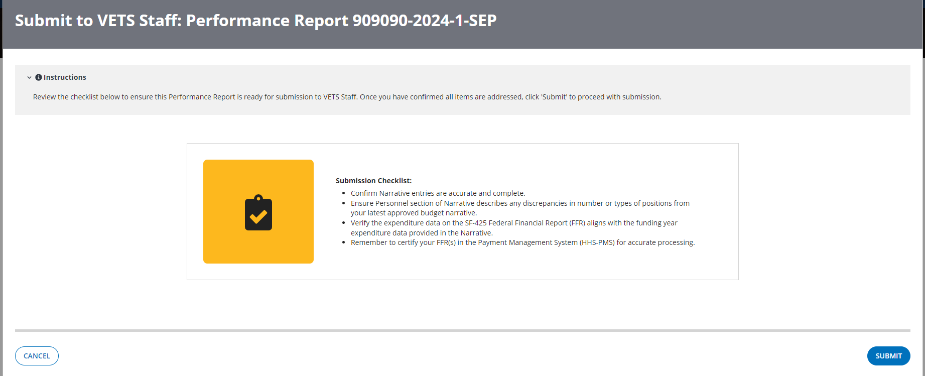
View Submit to VETS

Slide 87
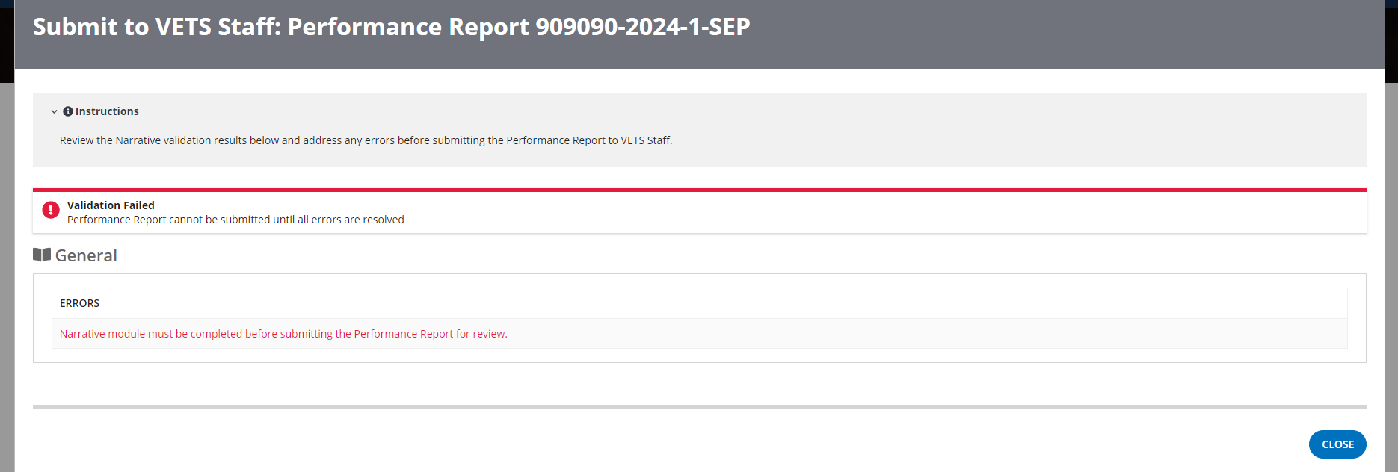
Validation Checker – Not Started

Slide 88
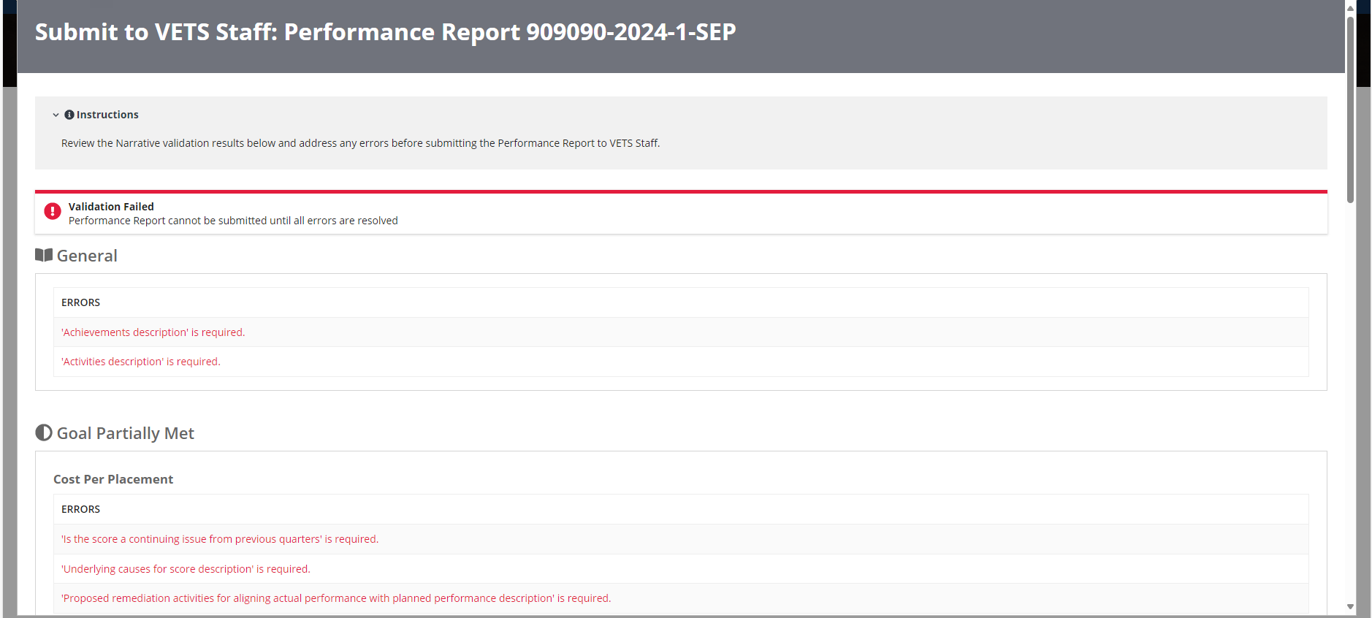
Validation Checker – Not Completed

Slide 89
Questions?

Slide 90
Thank You!

